Slide 1

The Mobile Phone Price Prediction System
The Mobile Phone Price Prediction System provides a quick and accurate way to estimate the value of mobile phones, empowering both buyers and sellers with real-time price insights.

Slide 2
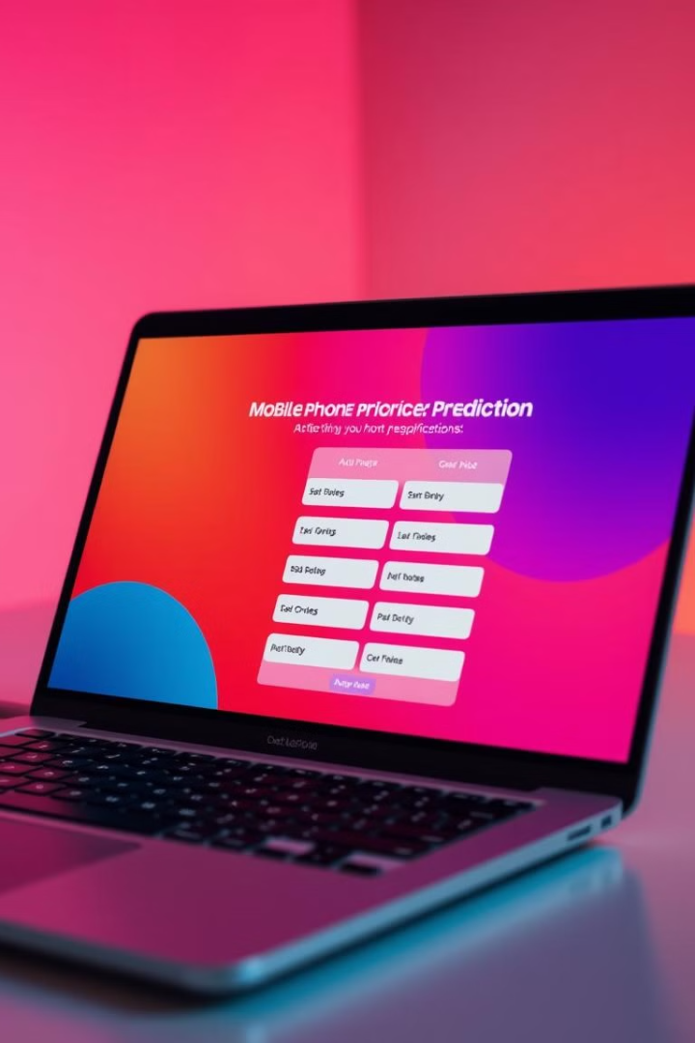
Introduction to the application
1
User-Friendly Interface
2
Machine Learning Integration
The application is designed with an intuitive and easy-to-use interface for seamless navigation.
The application leverages machine learning to analyze data and provide accurate price predictions.
3
Real-Time Price Estimates
Users receive instant price predictions based on the provided phone specifications.

Slide 3

Why this project?
Transparency and Fairness
Informed Decision-Making
Accurate price information promotes transparency and fairness in the mobile phone market.
Empowers buyers and sellers to make informed decisions regarding mobile phone purchases and sales.
Efficiency and Convenience
The application provides a convenient and efficient way to estimate mobile phone prices.

Slide 4

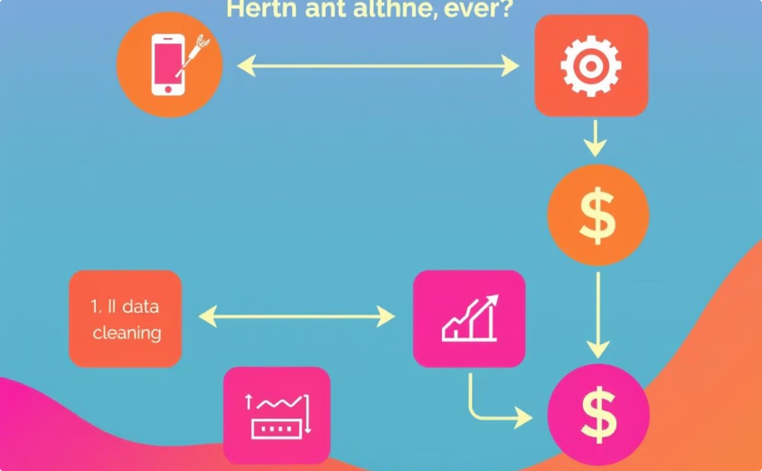
Data Visualization and Cleaning
Data Preparation
Machine Learning Model
The system begins by gathering raw data about mobile phones from various sources.
A machine learning model is trained on the cleaned data to learn the relationships between phone features and their corresponding prices.
This data is then cleaned and preprocessed to remove inconsistencies, missing values, and irrelevant information.
The model uses various algorithms to identify patterns and create a prediction model that can accurately estimate phone prices.

Slide 5

Combining machine learning and user-friendly interface
1
Data Collection and Analysis
A large dataset of mobile phone specifications and prices is used to train the machine learning model.
2
Model Training
The machine learning model learns the relationships between phone specifications and their corresponding prices.
3
User Interface Development
An intuitive and user-friendly interface is created to enable users to input phone details.
4
Prediction System Integration
The trained machine learning model is integrated into the application to provide real-time price estimates.

Slide 6
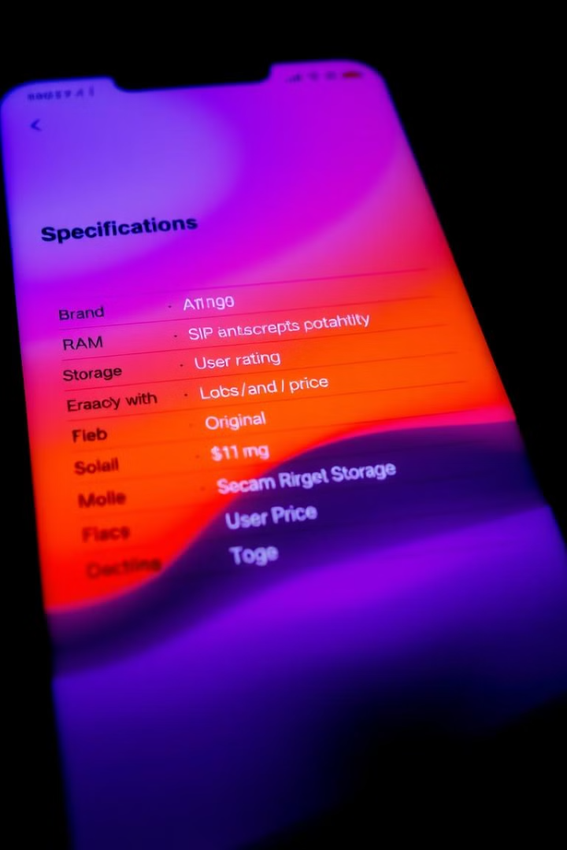
Data inputs and prediction model
Input Data
Description
Brand
The manufacturer of the mobile phone (e.g., Apple, Samsung, Google)
Memory
The amount of RAM available for processing (e.g., 4GB, 6GB, 8GB)
Storage
The amount of internal storage for data (e.g., 64GB, 128GB, 256GB)
Rating
The average user rating for the phone (e.g., 4.5 stars, 3 stars)
Original Price
The original retail price of the phone (e.g., $500, $1000)

Slide 7



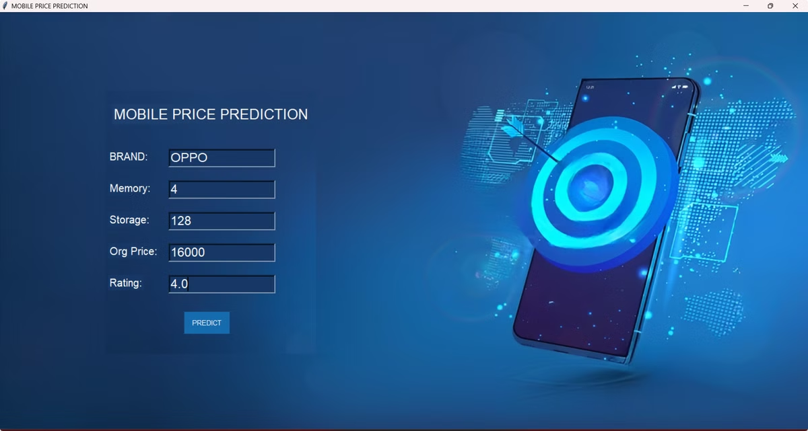


Intuitive Graphical User Interface (GUI)
Input Fields
Prediction Button
Users enter the phone specifications into clearly labeled input fields.
Clicking the prediction button triggers the machine learning model.
Prediction Results
Visual Insights
The estimated price is displayed in a clear and concise format.
Graphs and charts may be used to visualize price trends and comparisons.

Slide 8

Benefits for buyers and sellers
1
Buyer Confidence
2
Seller Profitability
3
Market Transparency
Buyers can feel confident that they are getting a fair price for their desired phone.
Sellers can maximize their profits by pricing their phones competitively.
The application promotes a more transparent and informed mobile phone market for all.

Slide 9

Thank You
We appreciate your interest in our mobile phone price prediction system.
We hope you find this application useful for your needs.

